Slide 1
CSCI-1620
Linked List II

Slide 2
LinkedList Data Members
  firstNode : type ListNode
    Reference to first ListNode in the list
  lastNode : type ListNode
    Reference to the last ListNode in the list
  numElements : integer
    Number of elements currently stored
  Name : type String
    The ‘name’ of the list

Slide 3
LinkedList Methods
  Constructors
  insertAtFront
  insertAtBack
  removeFromFront
  removeFromBack
  findAndRemove
  remove
  findItem
  lengthIs
  IsEmpty
  get
  print (instead of: toString)‏
  clear

Slide 4
New Exception
The remove methods are going to throw an Exception in the case that there is no Node to remove
For this we will create a brand new Exception to be used specifically for our LinkedList, the EmptyListException

Slide 5
Programmer Defined Exceptions
Programmers may define their own exception classes to handle application specific exceptions.
New exceptions can be defined to inherit from the ‘RuntimeException’ class
  If so, they will be unchecked Exceptions
  If you want an Exception to be checked inherit directly from Exception
New exception classes can be thrown and caught as needed by the application

Slide 6
EmptyListException
public class EmptyListException extends RuntimeException
{
public EmptyListException ()‏
{
this ("List");
}
// constructor with ‘String’ parameter
public EmptyListException (String name) {
// call super class constructor
super (name + " is empty");
}
}

Slide 7
LinkedList Constructors
There will be two constructors
Both set up an empty list by setting both the firstNode and lastNode to null, and numElements to 0
The constructor with no arguments will set the name of the list to “list”, the second will accept a name for the list

Slide 8
Insert Methods
insertAtFront
  Allows items to be inserted at front of list
  Can be used later for ‘Stack’ implementation
insertAtBack
  Allows items to be inserted at end of the list
  Can be used later for ‘Queue’ implementation

Slide 9
insertAtFront()‏
Two cases
  If the list is empty
    firstNode and lastNode now refer to the new Node
  List is not empty
    The new Node refers to the previous firstNode, firstNode now refers to the new Node

Slide 10
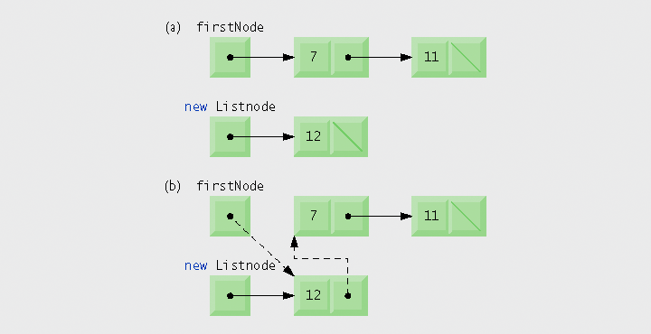
insertAtFront()‏

Slide 11
insertAtBack()‏
Two cases
  If the list is empty
    firstNode and lastNode now refer to the new Node
  List is not empty
    The lastNode's nextNode refers to the new Node, lastNode now refers to new Node

Slide 12
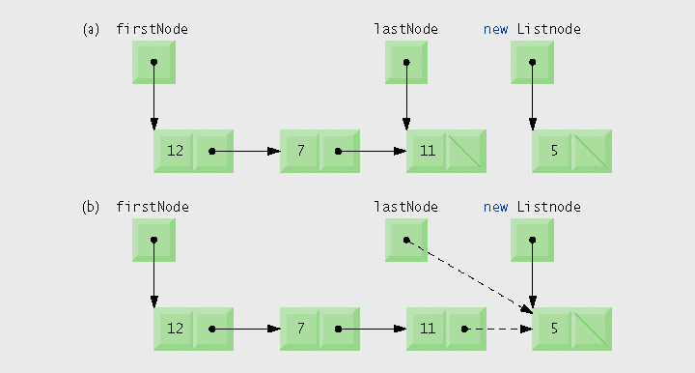
insertAtBack()‏

Slide 13
removeFromFront()‏
Three cases
  If list is empty
    Throw EmptyListException
  If list holds one element (firstNode == LastNode)‏
    List is now empty, set first and lastNode to null, decrease numElements, return removed item
  List holds more than one element
    Set firstNode to firstNode.nextNode, decrease numElements, return removed item

Slide 14
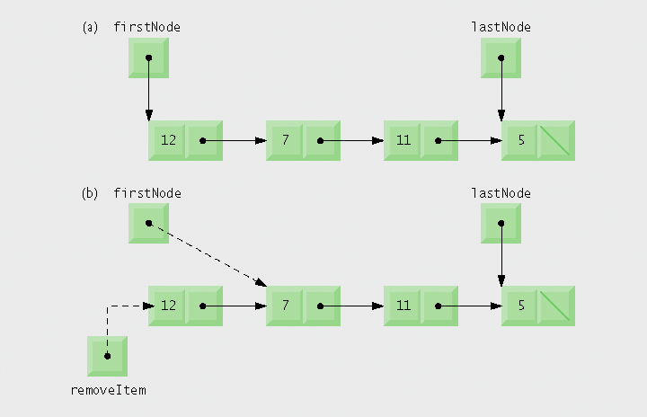
removeFromFront()‏

Slide 15
removeFromBack()‏
Three cases
  If list is empty
    Throw EmptyListException
  If list holds one element (firstNode == LastNode)‏
    List is now empty, set first and lastNode to null, decrease numElements, return removed item
  List holds more than one element
    Locate new lastNode by traversing the list until the second to last Node is found (the Node whose nextNode == lastNode, set its nextNode to null, and lastNode to this Node, decrease numElements, return removed item

Slide 16
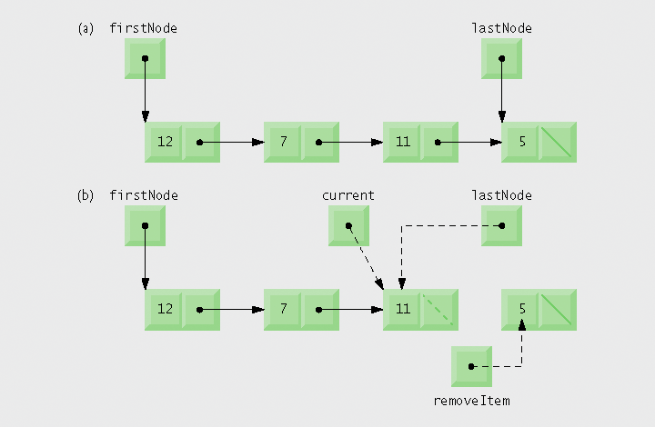
removeFromBack()‏

Slide 17
Other methods
lengthIs()‏
  returns numElements
isEmpty()‏
  Returns true if numElements == 0, false otherwise
print()‏
  Prints all elements on their own line
  This is in lieu of toString()‏
clear()‏
  Sets numElements to 0
  FirstNode and lastNode to null

